Slide 1


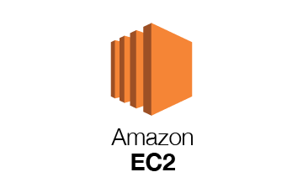
Name Registration number
Devin Yasas 11700006
Hikmatullah Nasiri 11816103
Mohammad Sabir Qasimi 11815937

Slide 3
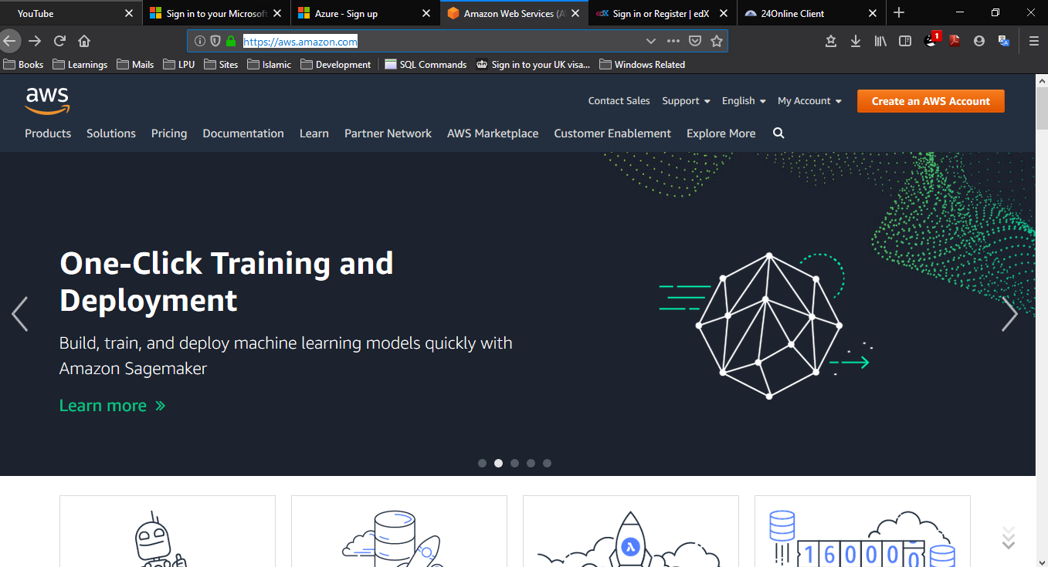
Create Amazon AWS Account
Step 1:
Go to https://aws.amazon.com .
Click on Create an AWS Account Button

Slide 4
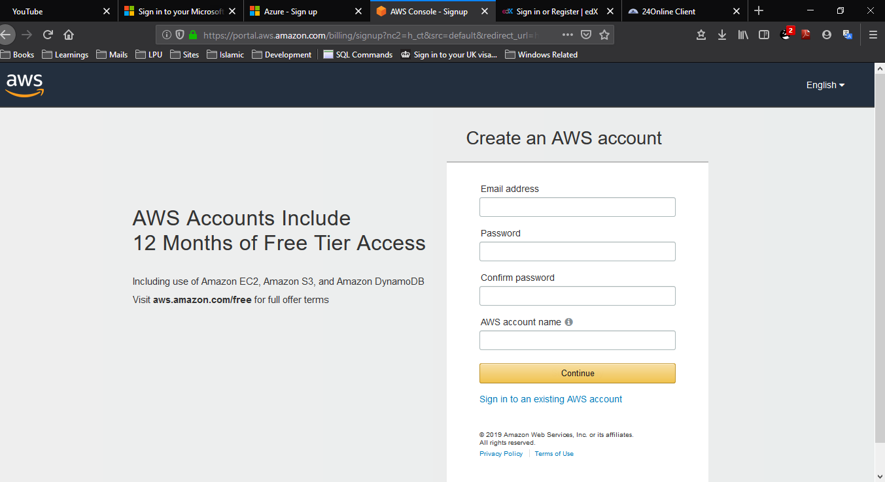
Step 2
Enter your Email and Password and Account Name

Slide 5
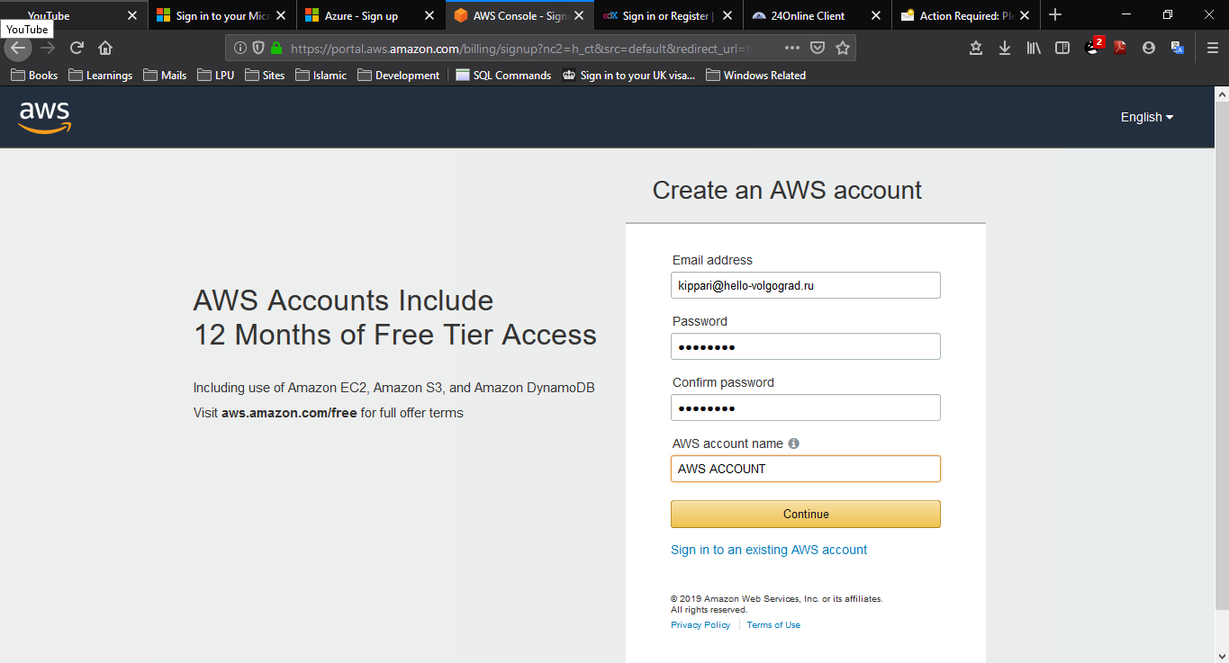
Step 3
Enter your Email , Password & Account Name
Click ON Continue button.

Slide 6
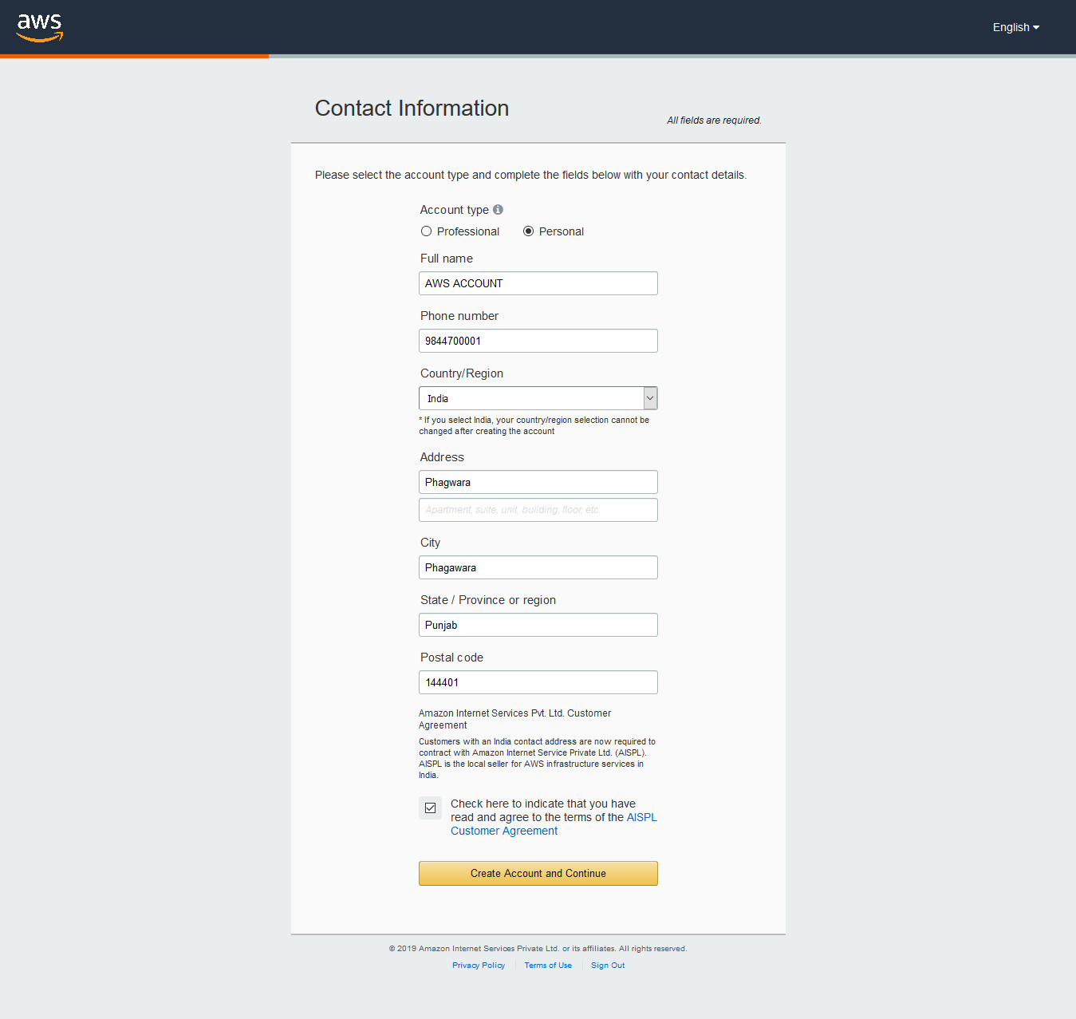
Step 4
Select Personal Account Type in Contact Information Page and fill the details.

Slide 7
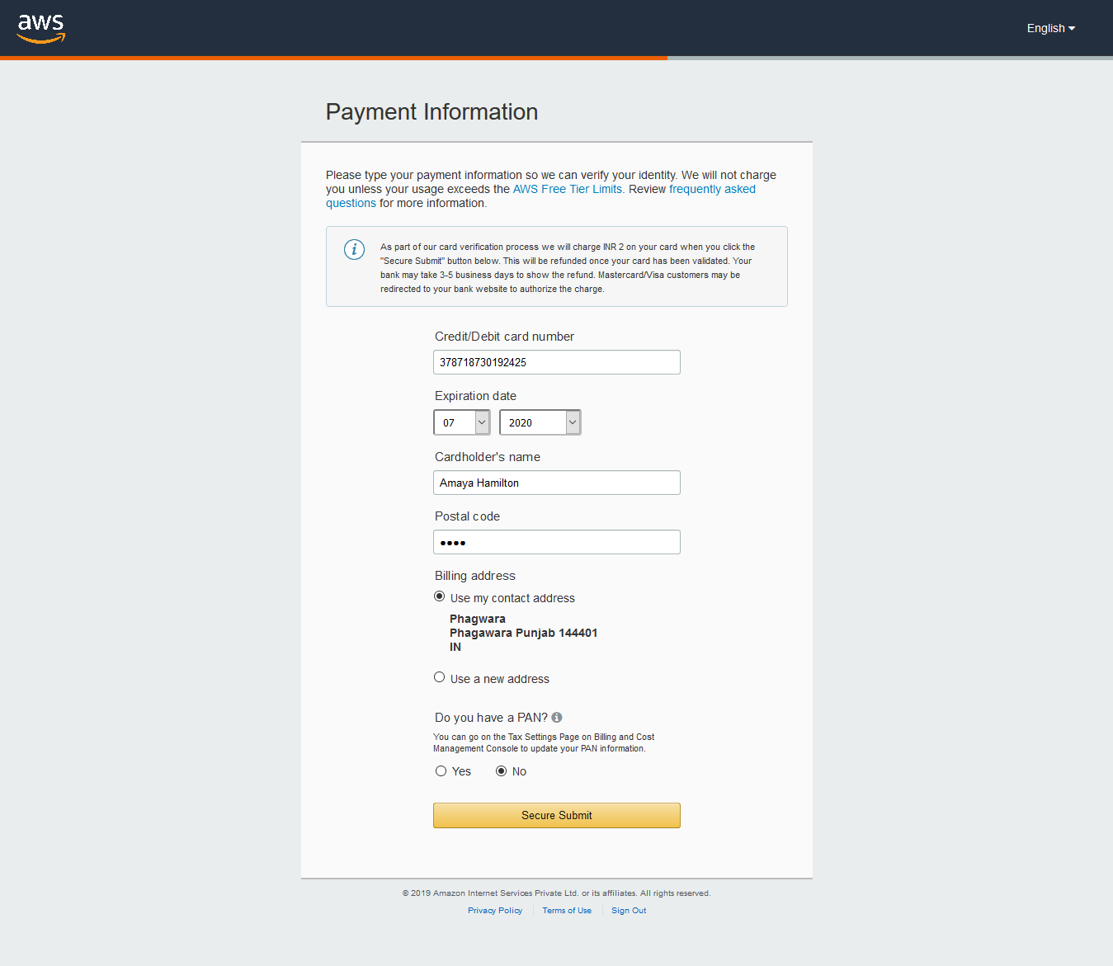
Step 5
Enter the Payment Information

Slide 8
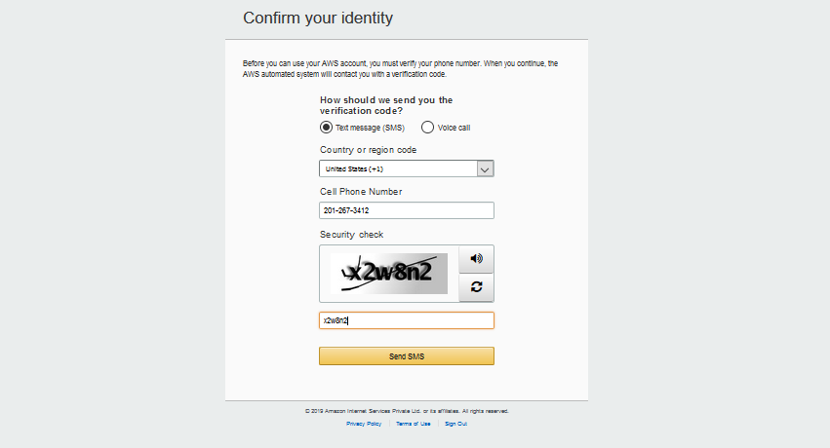
Step 6
Confirm your identity by entering Cell Phone Number.
Click Send Sms Button

Slide 9
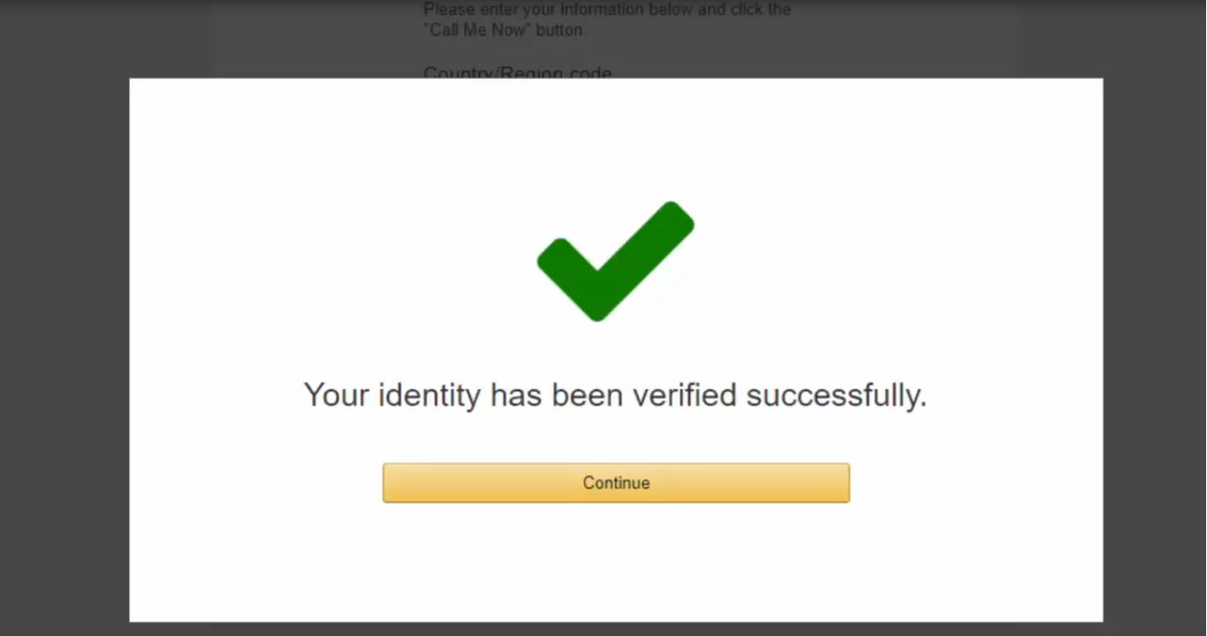
Step 7
Press Continue Button to Continue.

Slide 10
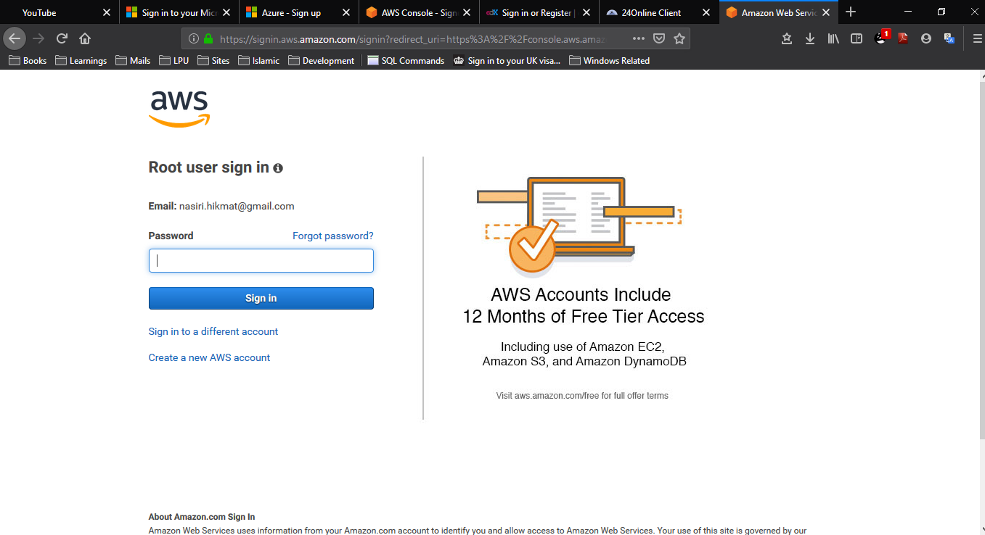
Step 8
Log in into your AWS account.

Slide 11
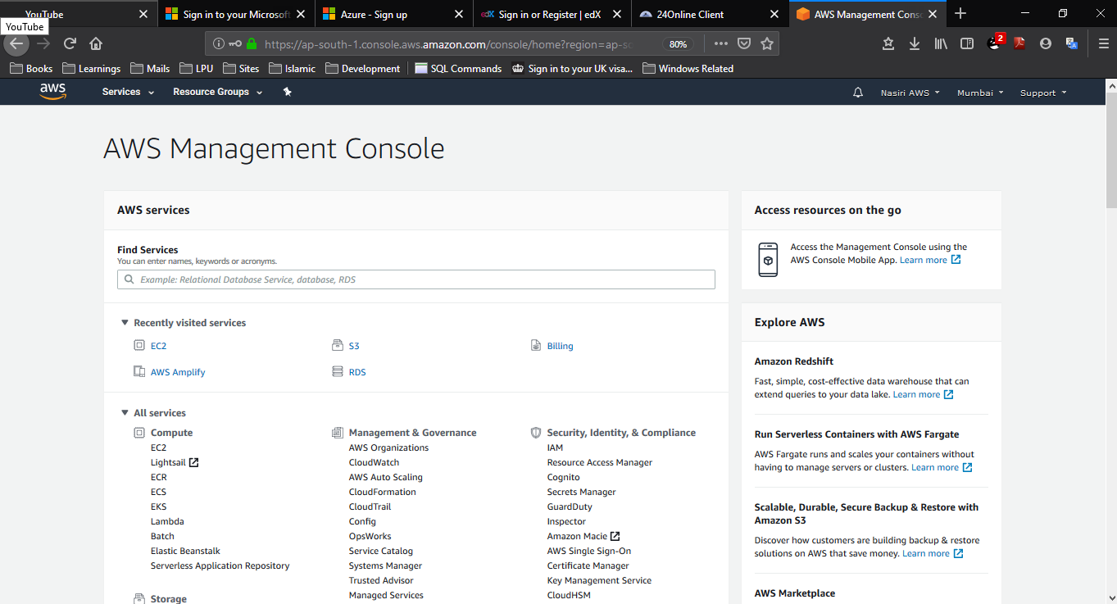
Step 9
Welcome to AWS Management Console

Slide 13
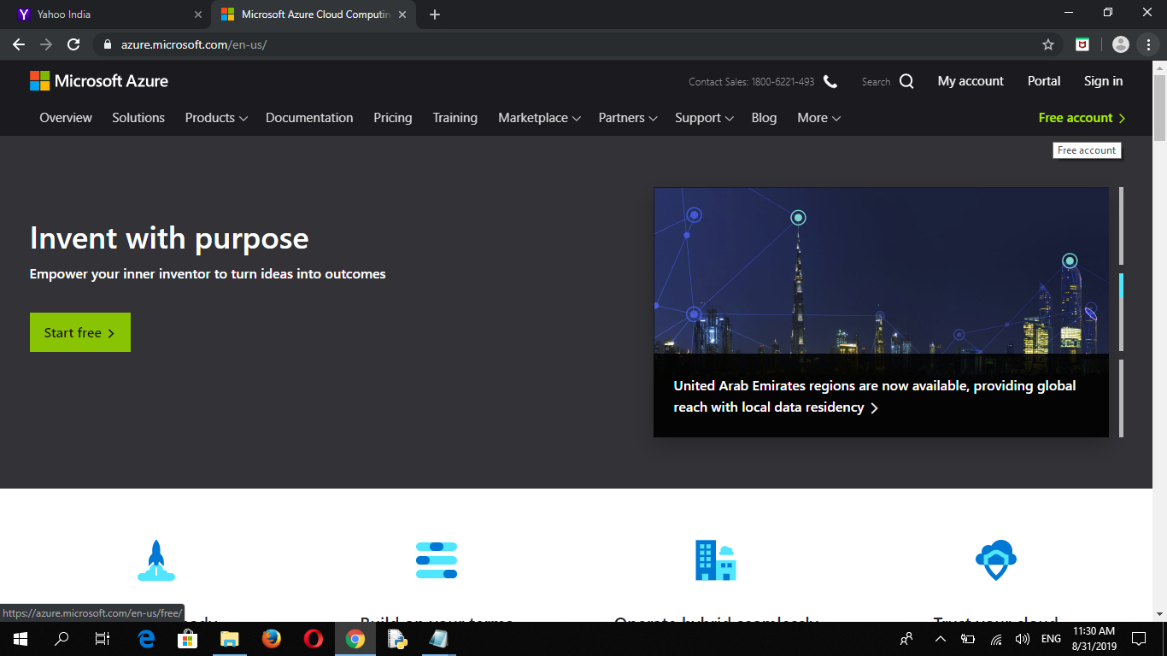
Microsoft Azure account setup
Step 1
Go to - https://www.azure.Microsoft.com/en-us/
Click free account (up right corner.)

Slide 14
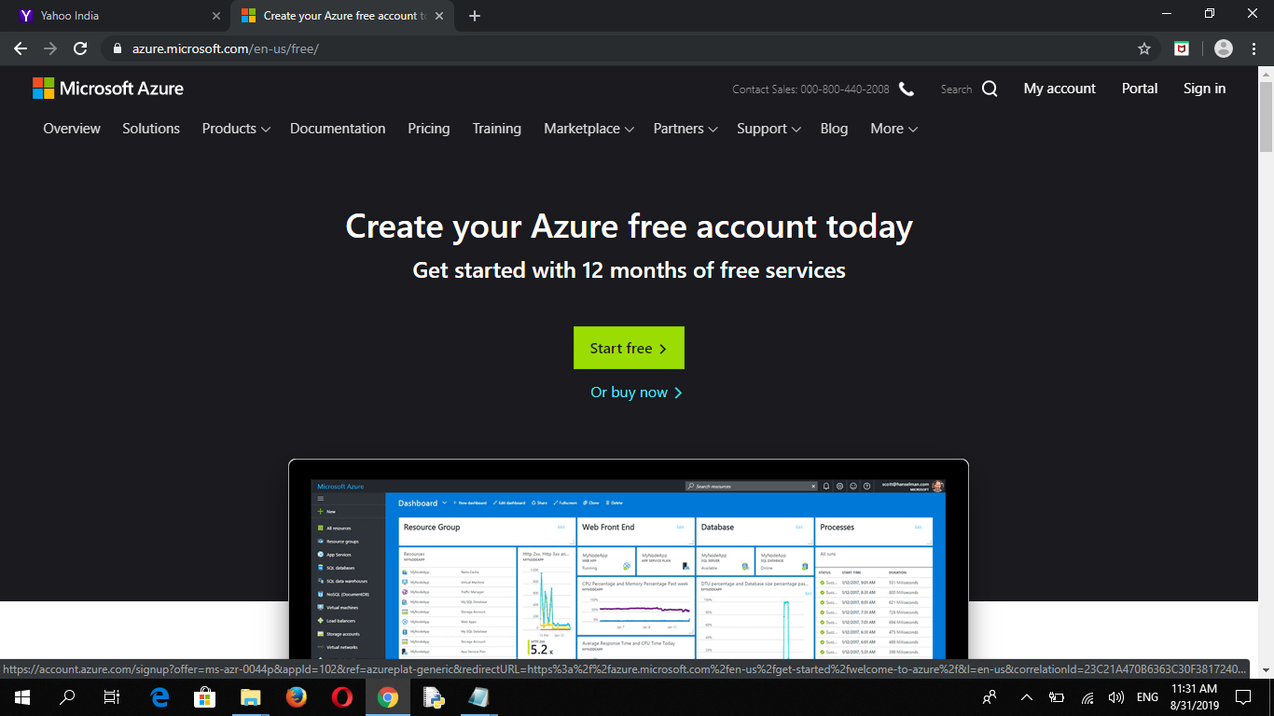
Step 2
Click Start free

Slide 15
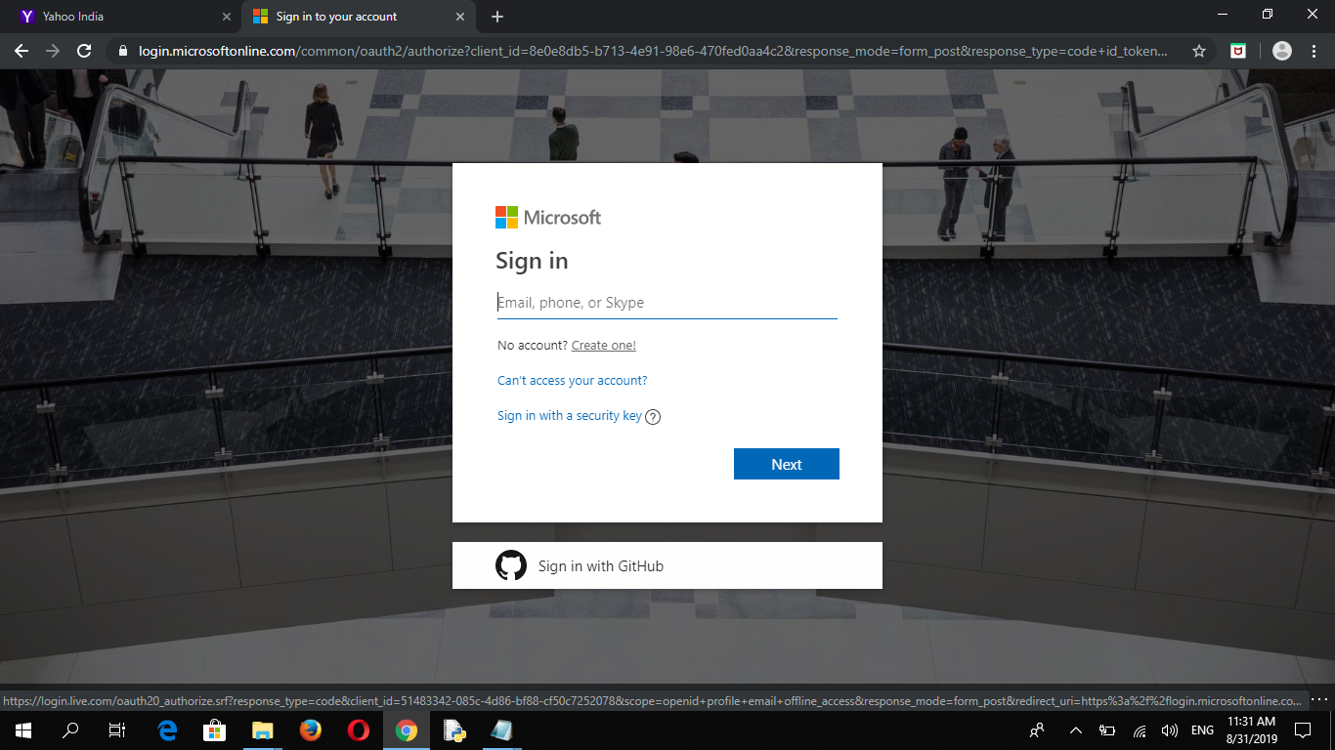
Step 3
If you Already have account enter username and password
New user click create one

Slide 16
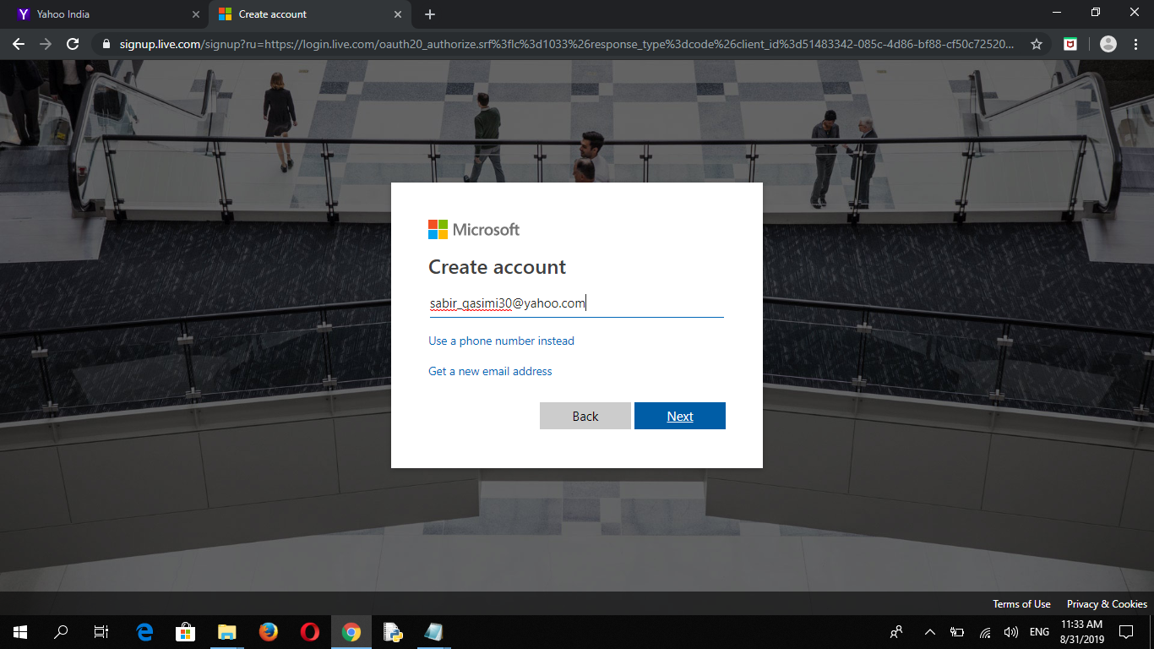
Step 4
We are creating new account.
First enter your email.
After click next.

Slide 17
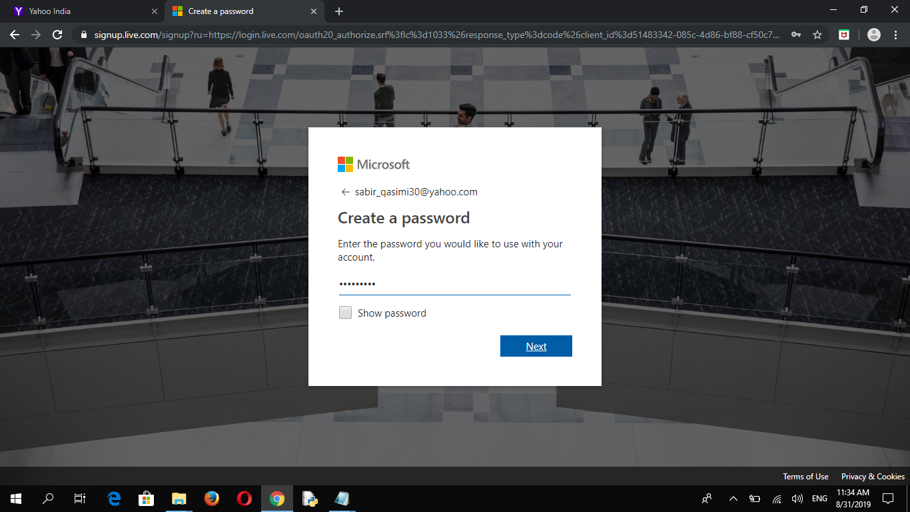
Step 5
Enter the password you would like to use with your account

Slide 18
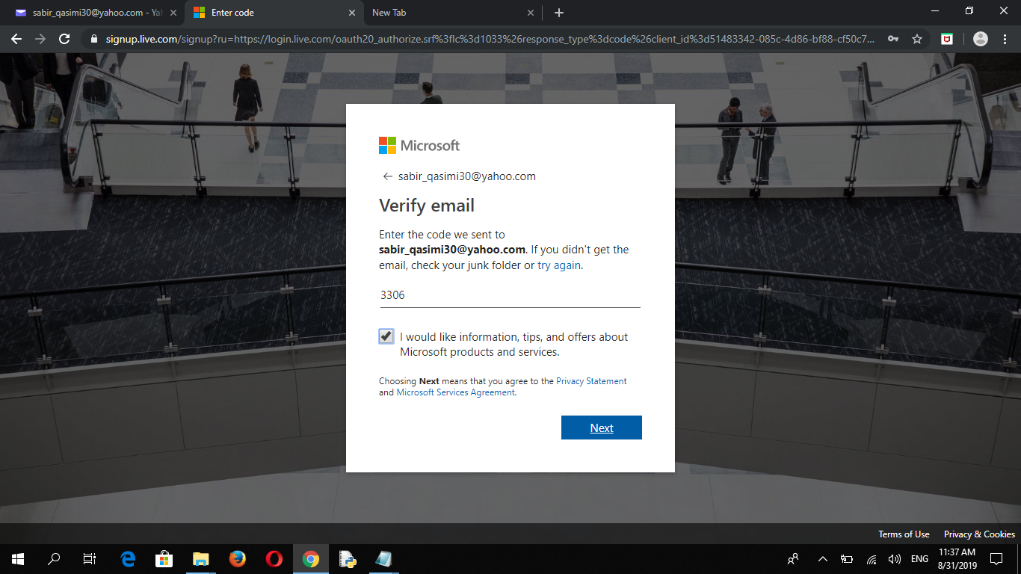
Step 6
Verify your email
Enter one time code send to your email
After that click next

Slide 19
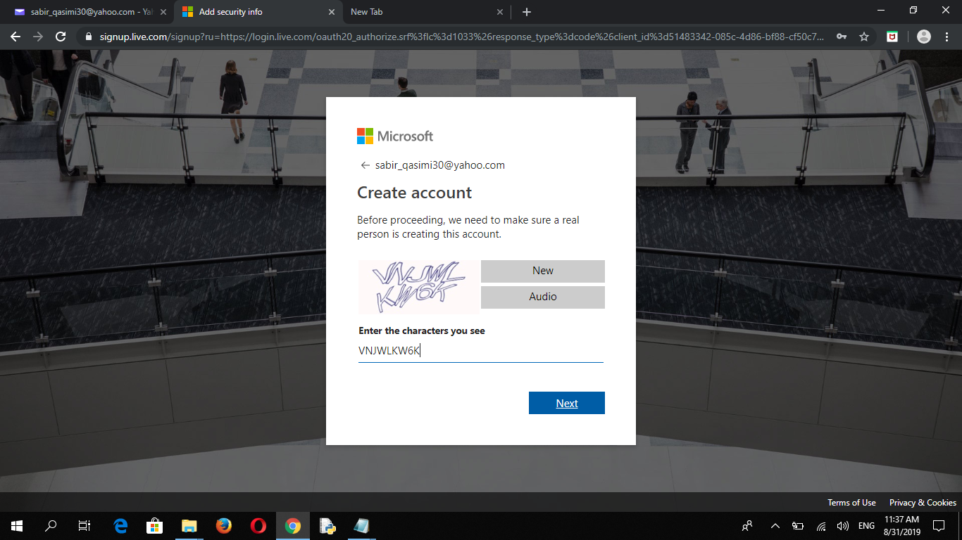
Step 7
Complete this task they need to make sure areal person is creating this account.

Slide 20
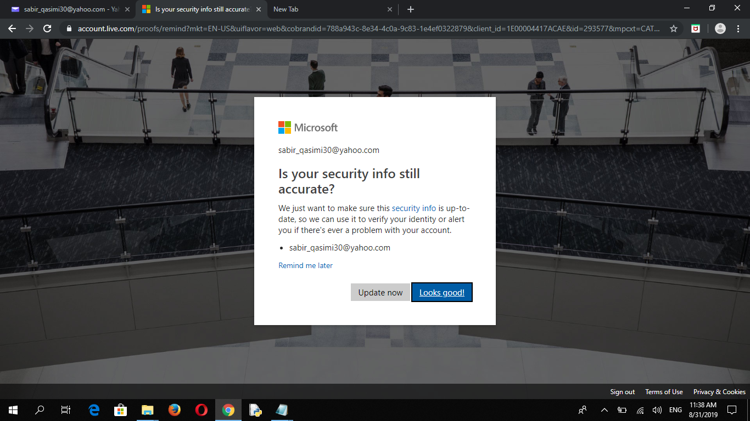
Step 8
Click looks good!

Slide 21
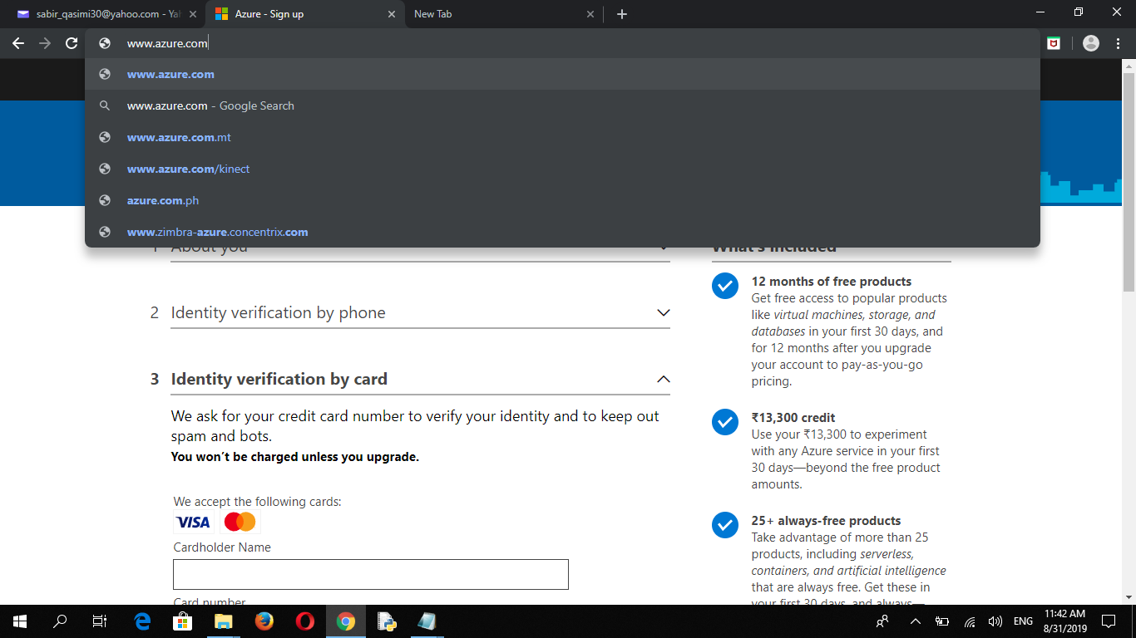

Slide 22
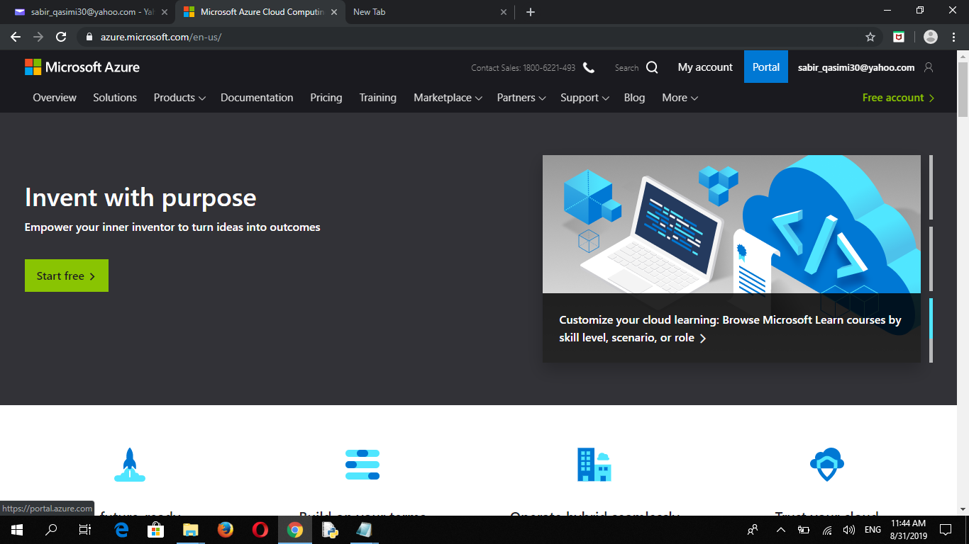

Slide 23
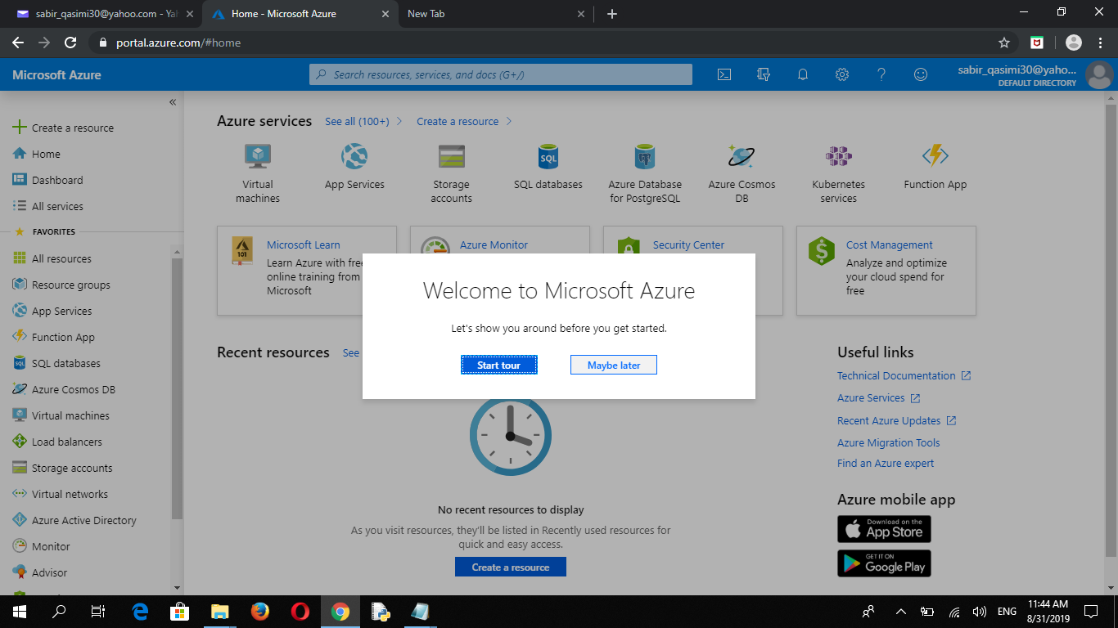
Step 9
Go to - https://www.portal.azure.com/#home
Click maybe later

Slide 24
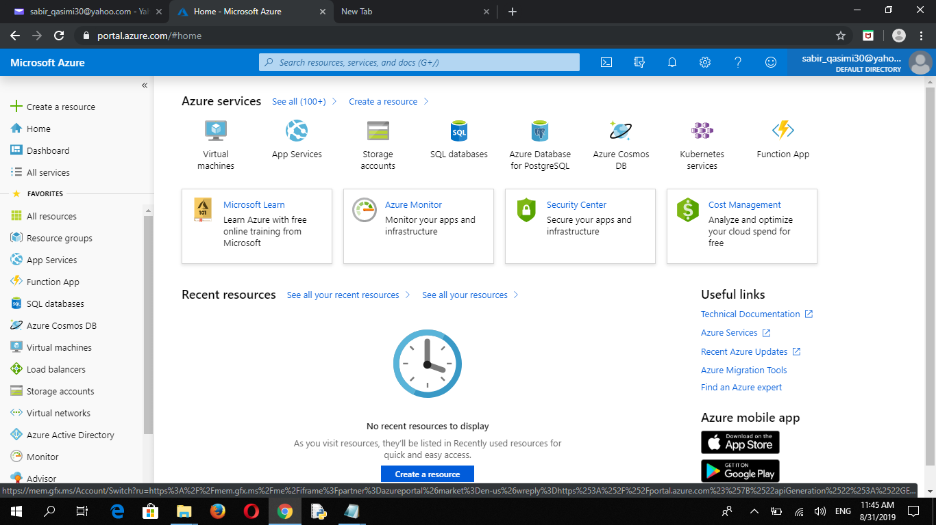
Your account is done

Slide 26
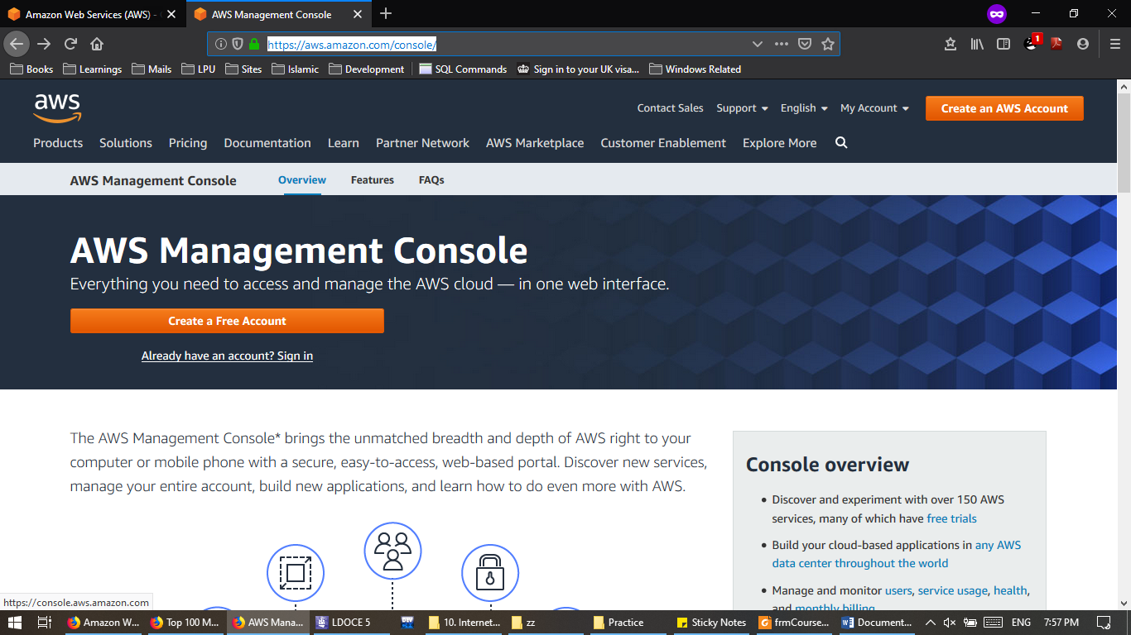
Amazon AWS Virtual Machine Setup
Step 1
Go to https://aws.amazon.com/console
Click on Already have an account? Sign in

Slide 27
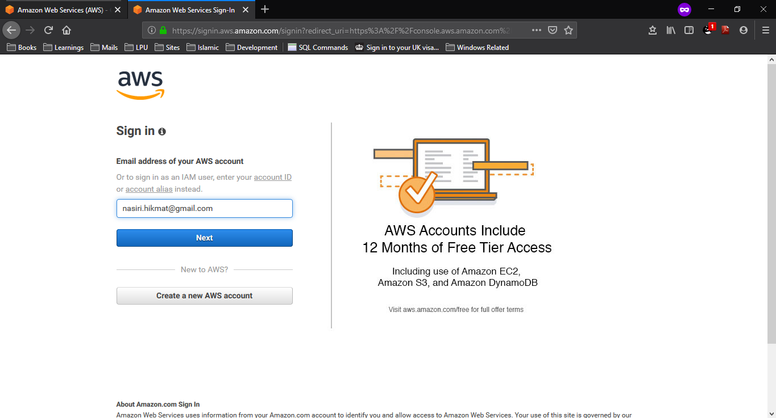
Step 2:
Sign into your Amazon AWS account

Slide 28
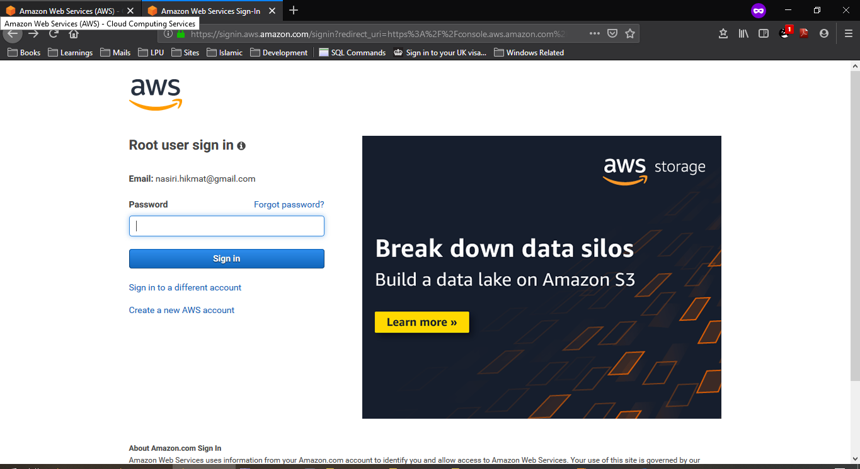
Step 3:
Enter the Password for Amazon AWS Account

Slide 29
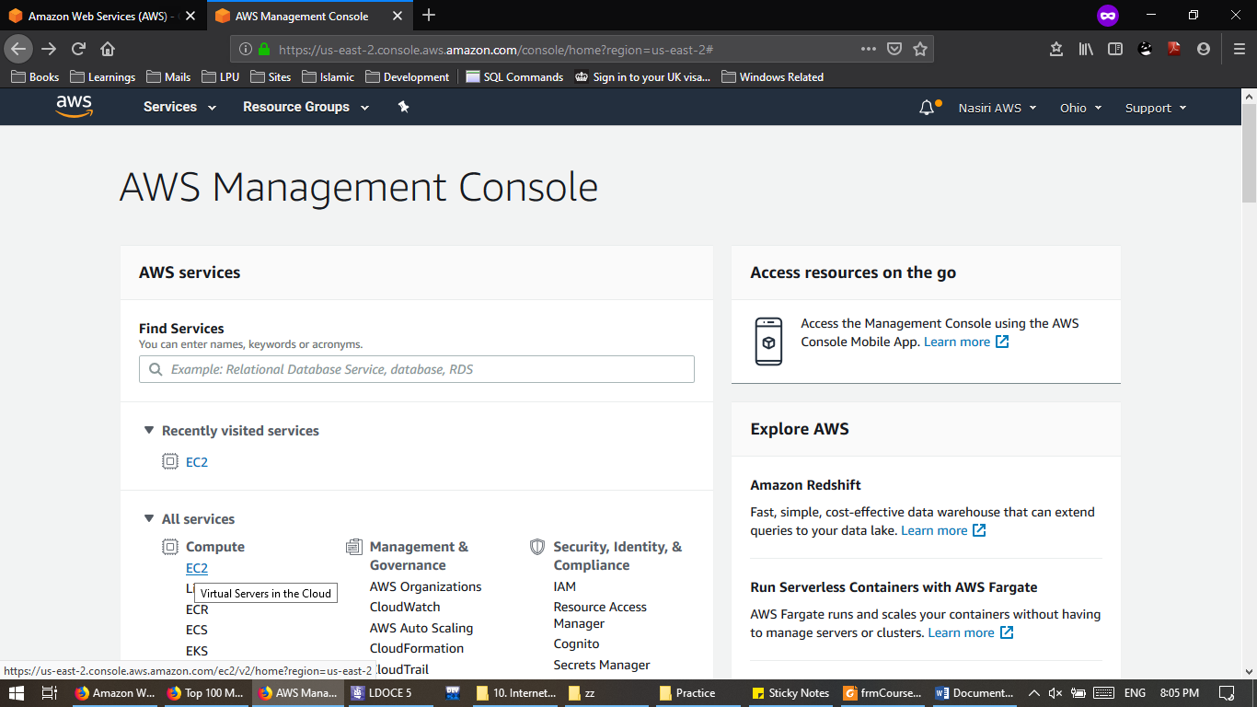
Step 4:
On Console Page Click on EC2

Slide 30
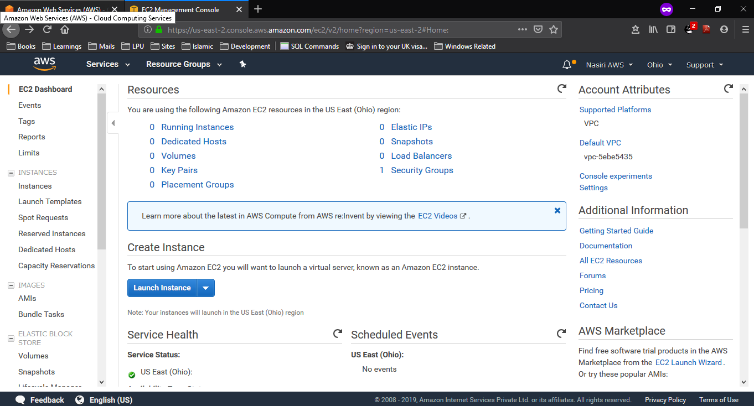
Step 5:
On EC2 Dashboard Click on Launch Instance

Slide 31
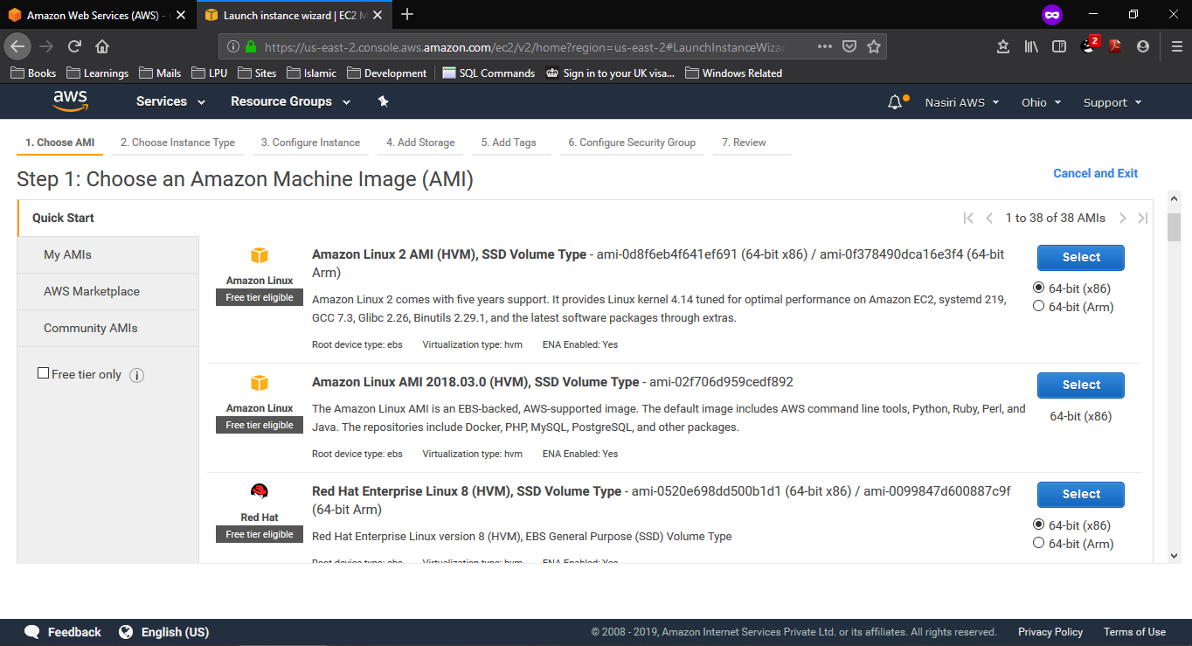
Step 6:
Select the Amazon Machine Image.
We will go for Ubuntu Server 18.04

Slide 32
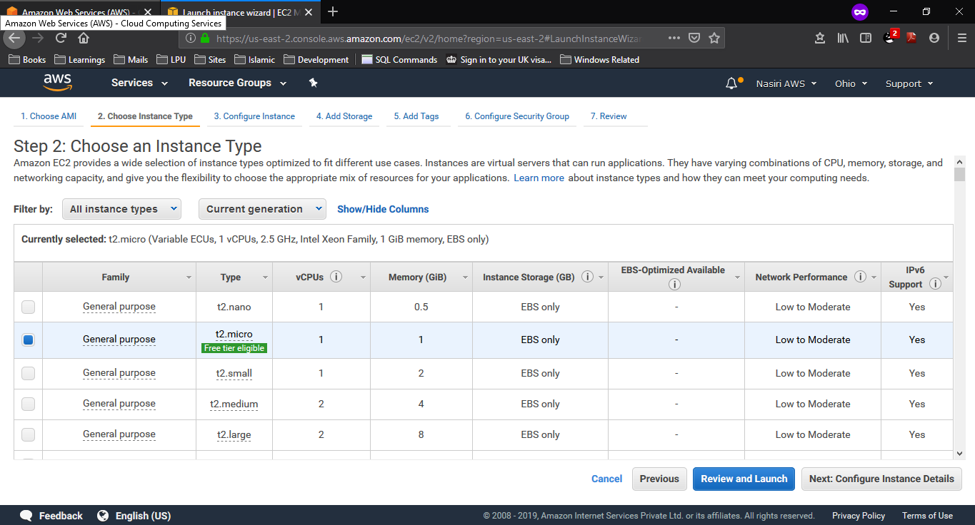
Step 7:
Choose an Instance Type Go for free Instance.
Next: Configure Instance Details.

Slide 33
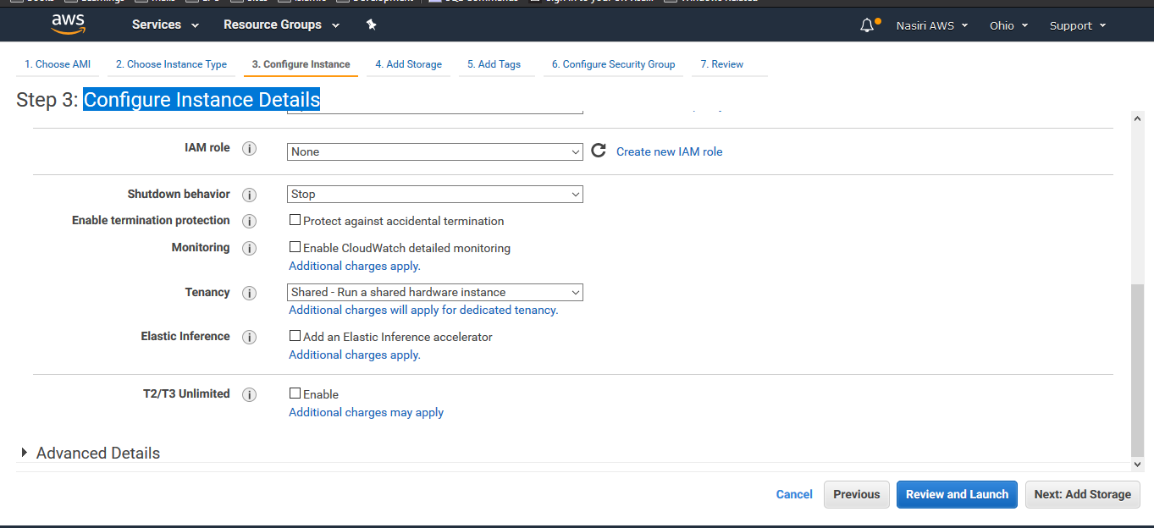
Step 8:
Configure Instance Details.

Slide 34
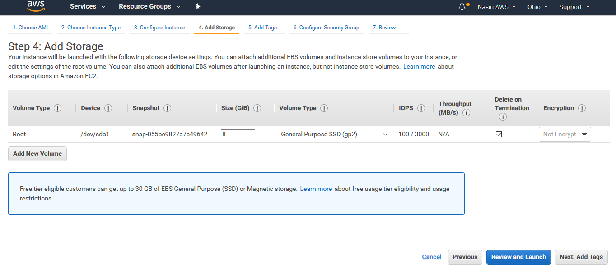
Step 9:
Add Storage.

Slide 35
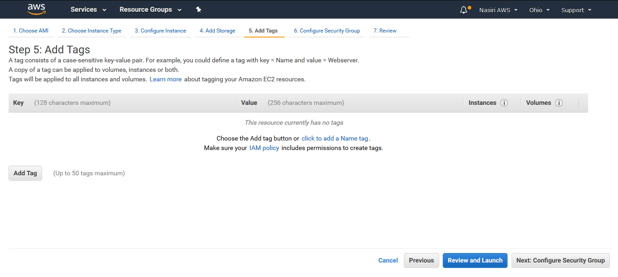
Step 10:
Ignore the Add Tags Page

Slide 36
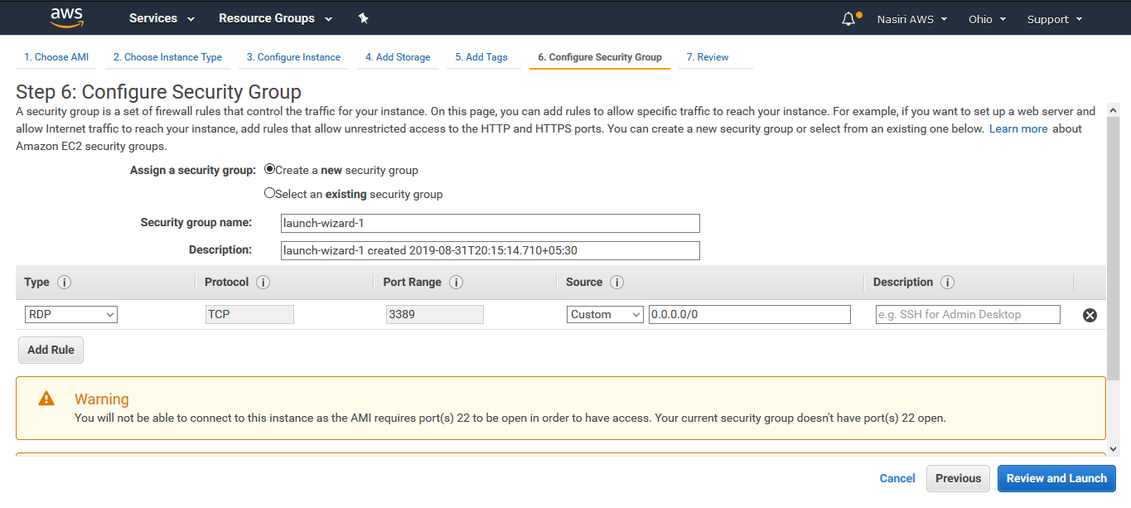
Step 11:
Configure Security Group go for RDP.
Review and Launch

Slide 37
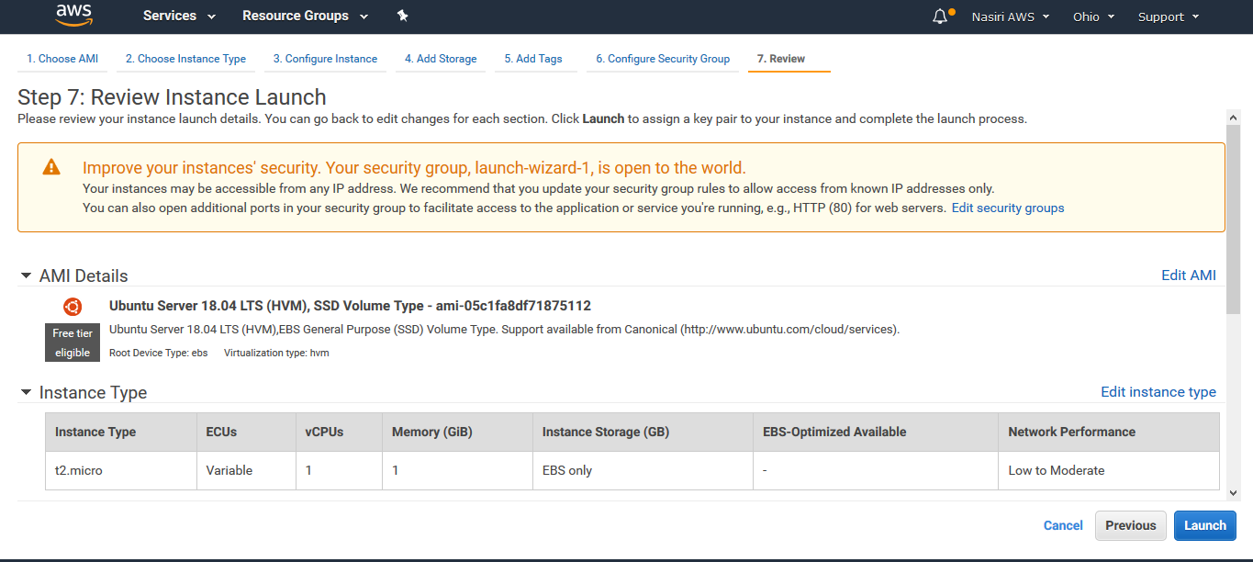
Step 12:
Launch.

Slide 38
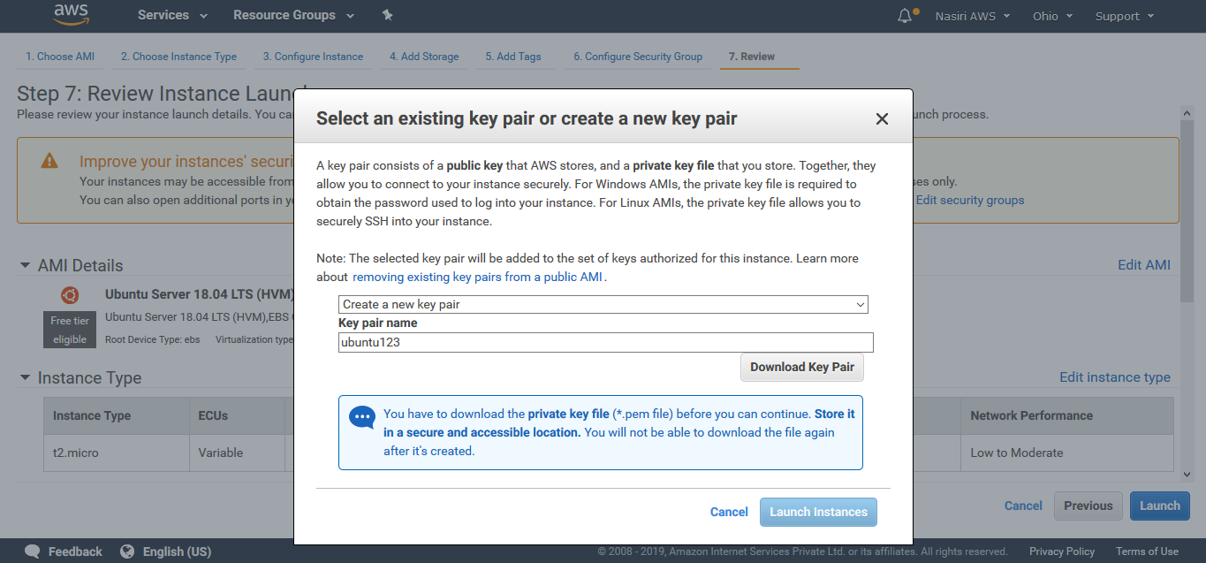
Step 13:
Create a new key pair type the pair name.
Download the Key Pair.
Launch Instances.
Click On View Instances.

Slide 39
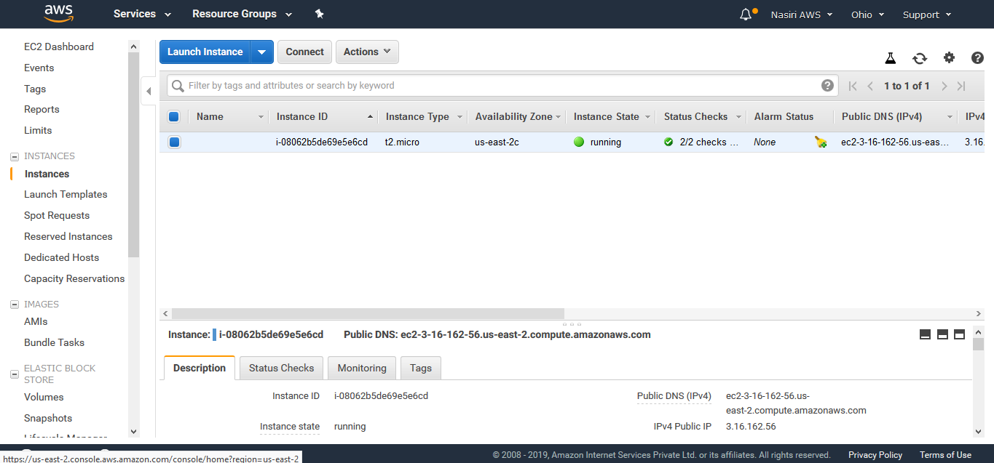
Log in to Virtual Machine
Step 14:
On Instances Page Click On Connect Button

Slide 40
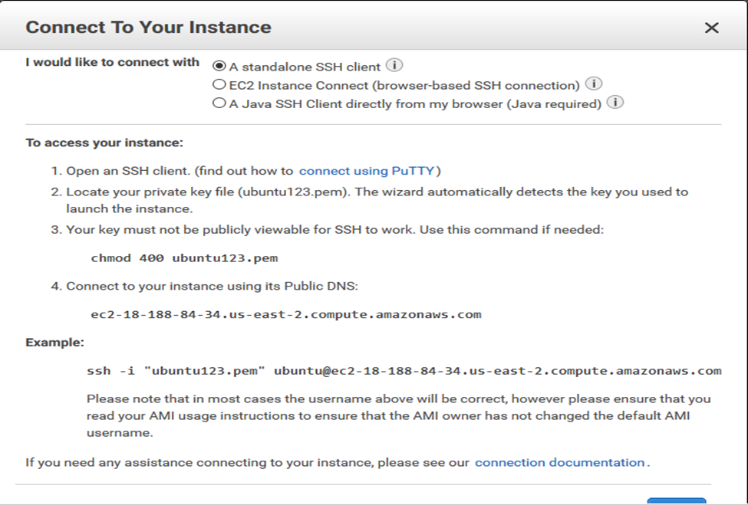
Step 15:
Connect to your instance using SSH command

Slide 41
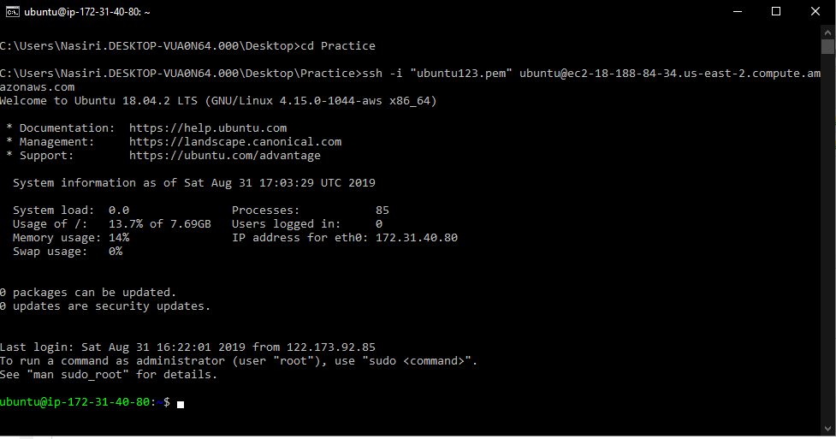
Step 16: Connecting through terminal.

Slide 42
